Slide 1



Fall 2017 COP 5725
School of Computer and Information Sciences
Topic Video: Hive
Yezehao Huai
PID:5965823
yhuai001@fiu.edu

Slide 2

A Story of Facebook
300+ million active users
30 million users update their statues at least once each day
More than 1 billion photos uploaded each month
More than 10 million videos uploaded each month
More than 1 billion pieces of content shared each week
-Facebook 2008
44 x 10¹² gigabytes per day today !

Slide 3

A Story of Facebook
Free or low cost
High scalability
Easy to study
Focus on the analytics

Slide 4
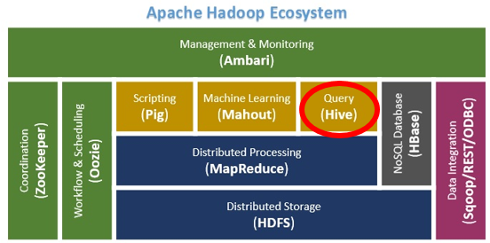
Hive
Apache Hive is a data warehouse software project based on Apache Hadoop and HDFS for data query, summarization and analysis. Hive QL is a SQL-like declarative language to compile queries expression into Map-Reduce jobs executed on Hadoop.

Slide 5
Data warehouse
HDFS
Map-reduce
Hive QL

Slide 6
Data warehouse
Data Warehouse is a large store of data accumulated from a wide range of sources within a company that support management decisions.
Subject Oriented
Integrated
Non-Volatile
Time Variant

Slide 7
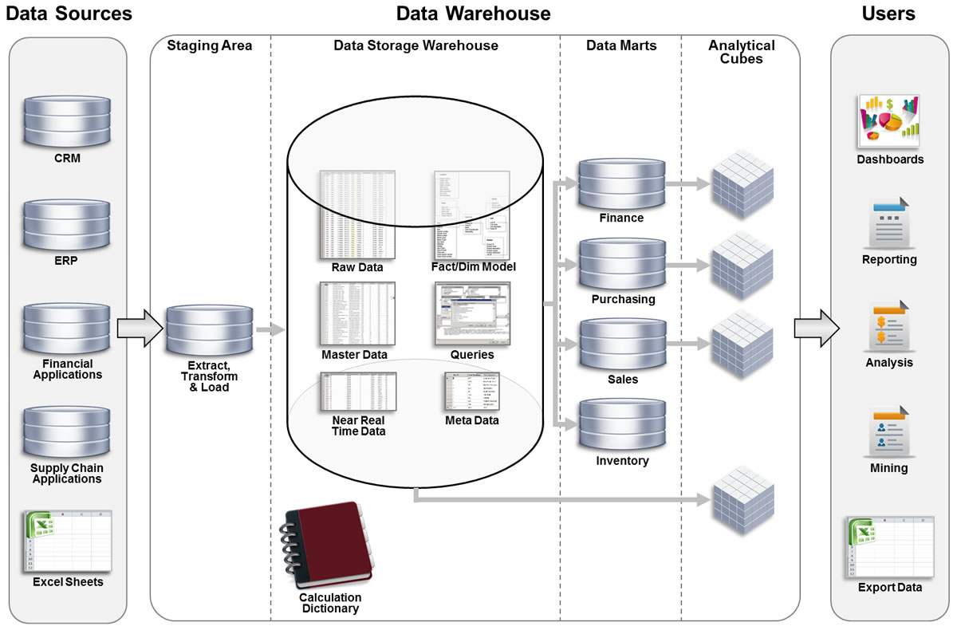
Data source→ Data Integration → Data Services → Data Application

Slide 8

HDFS

Slide 9
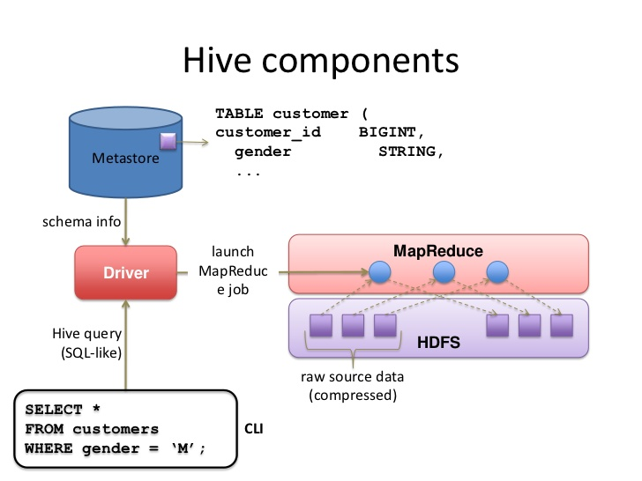
HDFS
The Hadoop Distributed File System (HDFS) is a distributed file system designed to run on commodity hardware.
The table is HDFS directory, the data is HDFS file

Slide 10
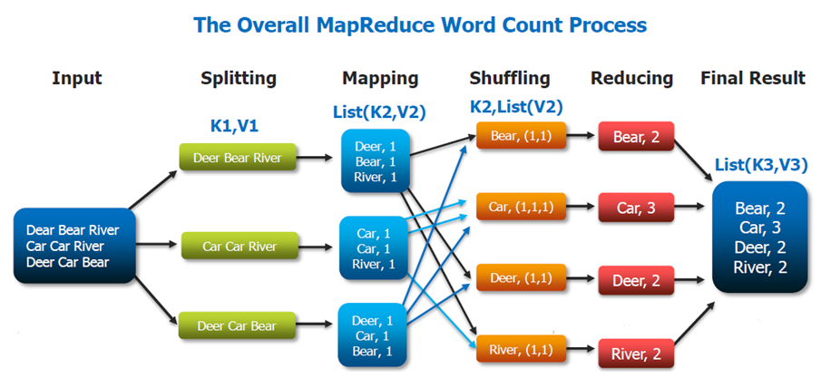
Map-Reduce

Slide 11
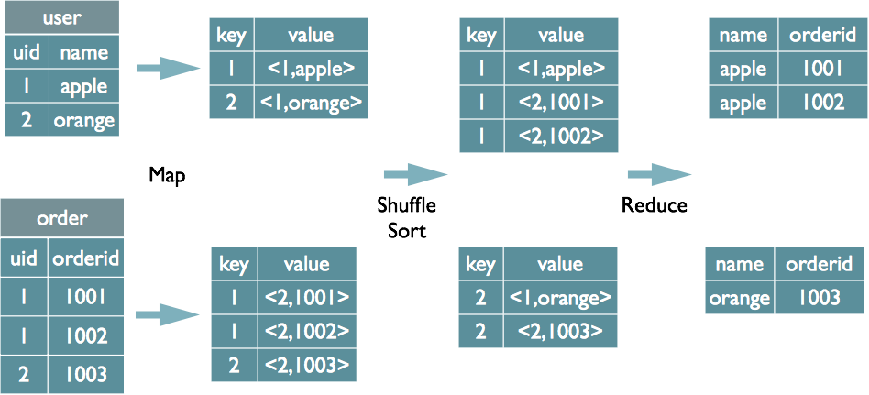
Map-Reduce

Slide 12
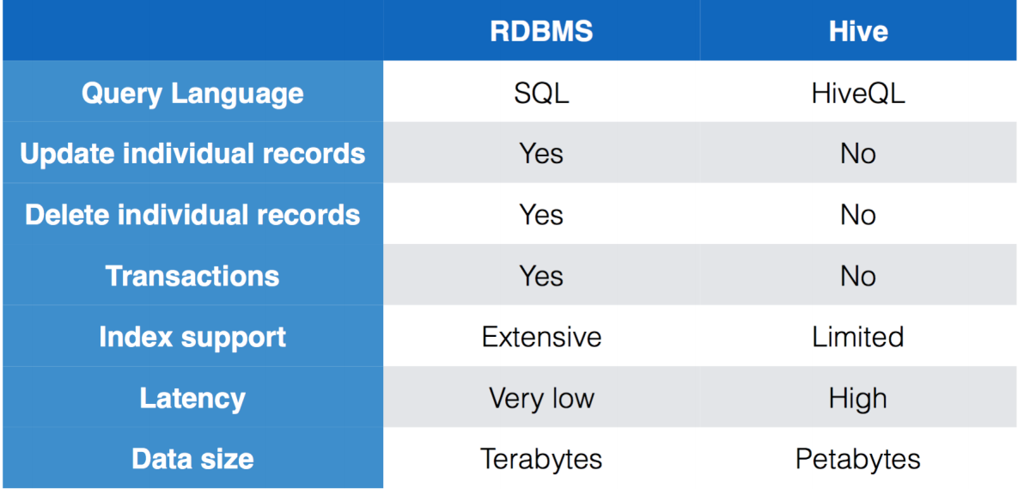
Hive QL

Slide 13
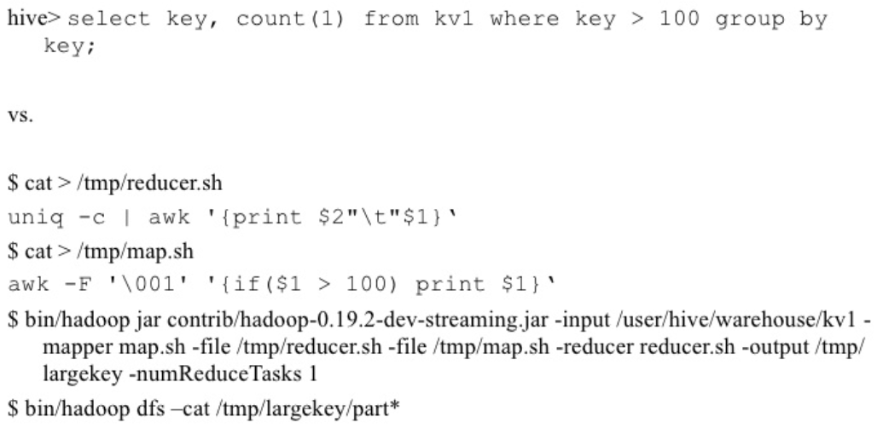
Hive QL

Slide 14
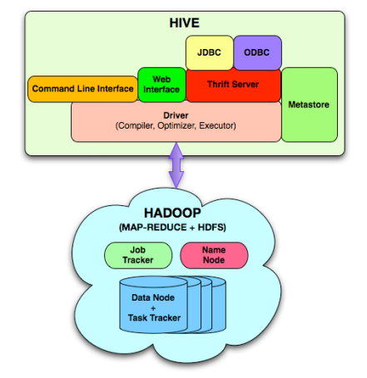
Hive Architecture

Slide 15
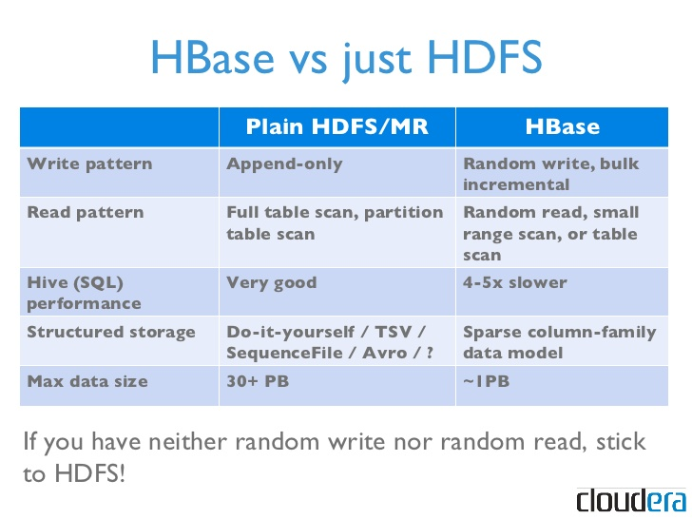

Slide 16
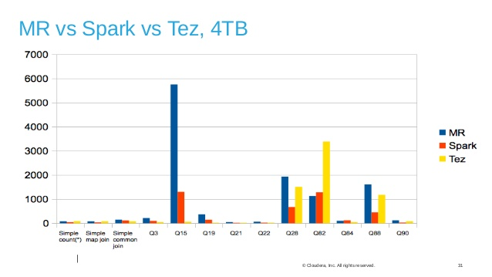

Slide 17
Conclusion
The Apache Hive™ data warehouse software facilitates reading, writing, and managing large datasets residing in distributed storage and queried using SQL syntax.
Built on top of Apache Hadoop™, Hive provides the following features:
Tools to enable easy access to data via SQL, thus enabling data warehousing tasks such as extract/transform/load (ETL), reporting, and data analysis.
A mechanism to impose structure on a variety of data formats
Access to files stored either directly in Apache HDFS™ or in other data storage systems such as Apache HBase™
Query execution via Apache Tez™, Apache Spark™, or MapReduce
Procedural language with HPL-SQL
Sub-second query retrieval via Hive LLAP, Apache YARN and Apache Slider.
Hive provides standard SQL functionality, including many of the later SQL:2003 and SQL:2011 features for analytics.
https://hive.apache.org/

Slide 18
Thank you
谢谢

